Slide 1
IS739 INFORMATION SYSTEMS IN ORGANIZATIONAL DESIGN AND APPLIED SYSTEM THINKING Systems Failures Thinking Case Study
M. Alphan Karadeniz

Slide 2
Case Study: Daleside Development Group
A Study of Failure of System Built Housing Projects
Construction and Building industry case
Might be valid for all industries and managers

Slide 3
What Happened?
Demand for housing increased in 1950s and 1960s
System building methods were introduced to Reduce time and cost for construction
New «system built public housing» methods utilized like kit-building
What was the result?
In the short term→ They achieved cutting costs and reducing time
In the long term → not so.

Slide 4
And Later?
By the mid-1980s at least 170 000 houses + hundreds of tower blocks deteriorated
Tenants suffered ill-health and loss of amenity
Local authorities were under pressure on two costly options:
Remedial treatment
Destruction and replacement
An Analyst, whose client is a local authority director of housing, started to work…

Slide 5
Objectives of Analyst
Develop own career
Influence the direction of housing policy
Advise client on potential pitfalls
Long Term - Personal
Long Term - Project
Short Term – Project
Gain some insight into system-built housing situation in time available
See what lessons could be learned in time available
Analyze situation competently
Manage time effectively
Manage data collection effectively
Manage analysis effectively
Manage reporting effectively
Short Term – Project
Short Term – Project
Short Term – Project
Short Term - Project

Slide 6
Where to Start?
Data Collection
Sources:
Personal observations
Personal interviews
Literature search (reports, documents, press cutting)
Telephone enquiries
TV reports

Slide 7
Analysis
Follow Systems Failures Methodology
Stage 1: Describe the failure situation
Stage 2: Comparison with paradigm
Stage 4: Learning
Stage 3: What do comparison mean?

Slide 8
Stage 1: Systems Description and Paradigm Selection
To assemble key SYSTEMS to work on…
Awareness
Public housing experienced difficulties
More dwellings required in a cheaper way
Homeless people waiting
Housing aids from central government cut

Slide 9
Stage 1: Systems Desc. and Paradigm Select.
Commitments
Director of housing (client-problem owner) told;
«I am aiming for success not failure»
Testing
Is the client’s purpose relevant to the failure situation? YES
Is the commitment goal-oriented? YES
Is analysis more important than action at present? YES
Is analysis need-driven rather than just to satify curiosity? YES
The test results indicate that systems analysis is warranted.

Slide 10
Stage 1: Systems Desc. and Paradigm Select.
Separation of Systems
Which area should be focused?
New build → Daleside Development Group Project for «System Building».
Maintenance and improvement
Housing the homeless

Slide 11
Stage 1: Systems Desc. and Paradigm Select.
Separation of Systems (description of the system)
DDG was a consortium formed by 4 city councils in 1960s. In 1968, the group disbanded
DDG senior management did not met in 1968 – 1982
Over that 14 years; water seepage, dampness, mould and fungus were problems for tenants
Physical and mental health of tenants were affected
DDG houses were in an advanced decay (Although their life time expected 60 years)
The national media focused on DDG scandal

Slide 12
Stage 1: Systems Desc. and Paradigm Select.
Separation of Systems
More elements to be considered
Management left Designer (Richard Stevenson) to choose system building method
Swallow Construction put in a very low bid and were accepted
Stevenson blamed
Swallow for underestimating the difficulties involved in building to his complex design
Factories where the prefabricated panels made
Poor workmanship

Slide 13
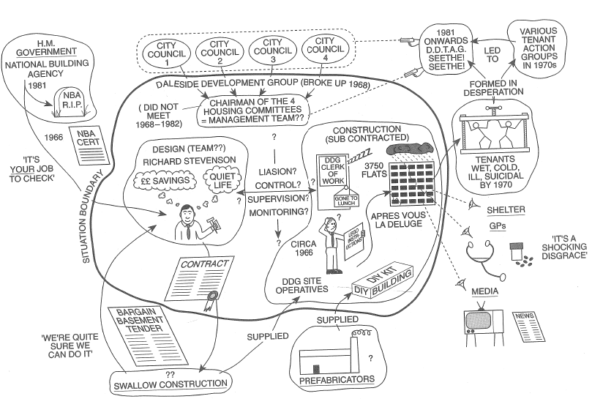
Analyst summarize his perception of the DDG situation in a rich picture

Slide 14
Stage 1: Systems Desc. and Paradigm Select.
Likely components in DDG Project System
Within SYSTEM
Four chairmen
Designer (Stevenson)
In the Environment
Tenants
Swallow Construction
Briefing for designer
Design
Factory making pre-cast components
Factory quality control
Government finance
Tendering
Construction
Workmanship on site
Repair / Maintenance
Checks on materials
Fire precautions

Slide 15
Stage 1: Systems Desc. and Paradigm Select.
Selection
«New build» exhibited apparently significant failures
DETAILED DESCRIPTION OF SYSTEM
Components
Previous list was a adjusted and summarized as a system map →

Slide 16
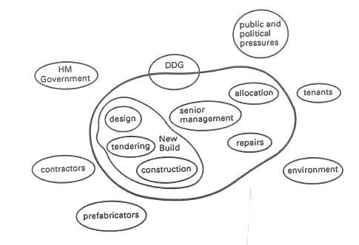
Stage 1: Systems Desc. and Paradigm Select.
Components

Slide 17
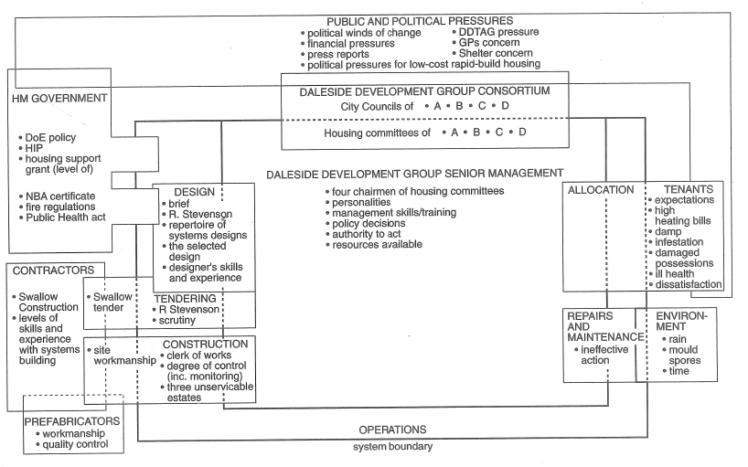
Stage 1: Systems Desc. and Paradigm Select.
Components

Slide 18
Stage 1: Systems Desc. and Paradigm Select.
Inputs
Wider system policies,
management skills,
resources,
design skills,
repertoire of building methods,
prefabrication skills,
materials,
tenants

Slide 19
Stage 1: Systems Desc. and Paradigm Select.
Outputs
System-built estates (largely unserviceable)
Sitting tenants (largely dissatisfied)
Complaints from tenants to GPs, DDTAG (the tentants’ action group), the press

Slide 20
Stage 1: Systems Desc. and Paradigm Select.
Environment
Government, physical environment, public and political pressures, Swallow construction, prefabricators, DDTAG
Structure
Appearent DDG subsystems
Design
Tendering
Construction
Allocation
Repairs and Maintenance

Slide 21
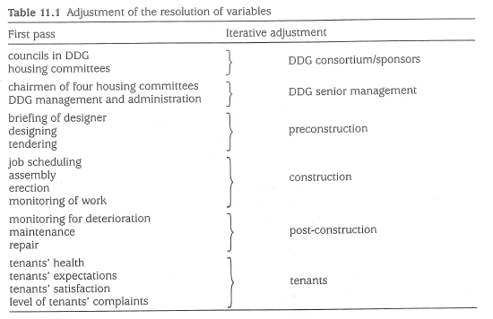
Stage 1: Systems Desc. and Paradigm Select.
Variables
Lots of variables listed
Iterative adjustment to make more manageable

Slide 22
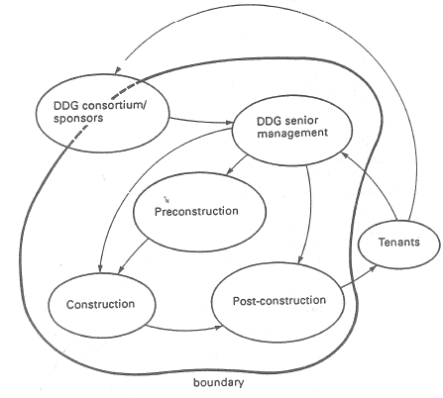
Stage 1: Systems Desc. and Paradigm Select.
Relationship between Variables

Slide 23
Stage 1: Systems Desc. and Paradigm Select.
Apparently Significant Failures (in 4 categories)
Pre- Construction
Managers gave the designer too much latitude
No check for NBA certificate
Poor investigation on tenderers
Construction
Lack of quality monitoring (prefabrication and workmanship)

Slide 24
Stage 1: Systems Desc. and Paradigm Select.
Apparently Significant Failures (in 4 categories)
Structural failures after completion
Concrete panels did not fit – no watertight connections
Bad sealings → rain penetration
Bad insulation → high heating bills
Load cracks
Management failures after completion
Chairmen met only once in 14 years

Slide 25
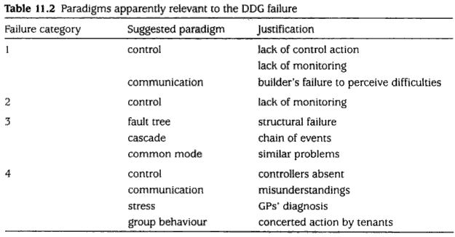
Stage 1: Systems Desc. and Paradigm Select.
Appropriate Paradigms
Apparently relative models from the repertoire:

Slide 26
Stage 2: Comparison
5 comparisons between system and paradigms
FSP, Control, Communication, Cascade, Fault Tree

Slide 27
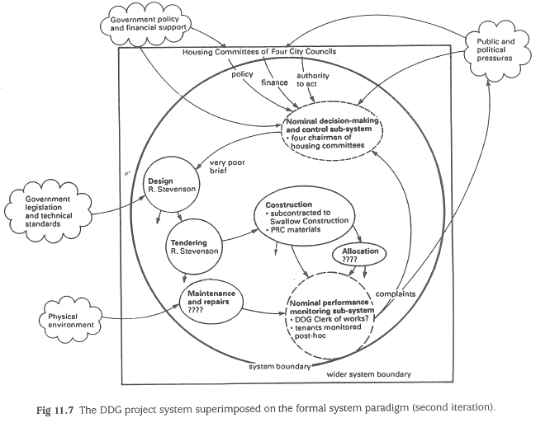

Slide 28
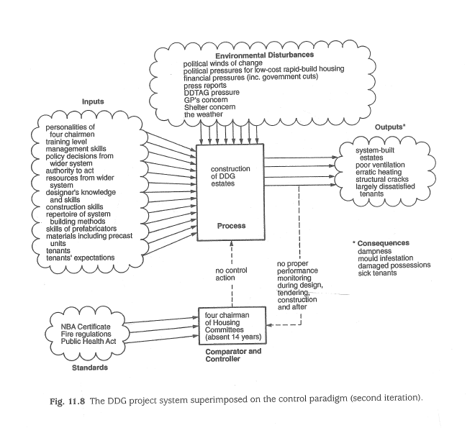

Slide 29
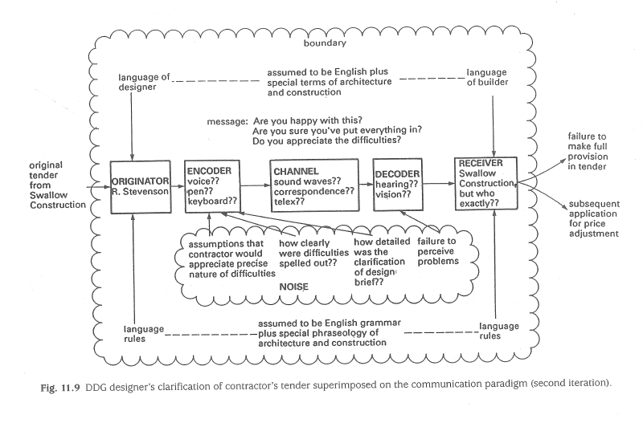

Slide 30
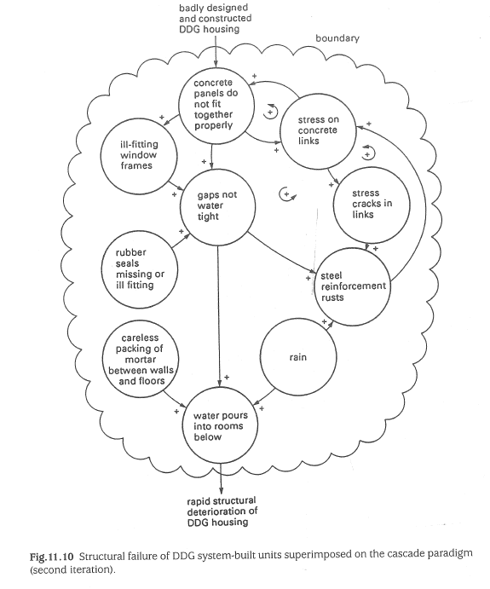

Slide 31
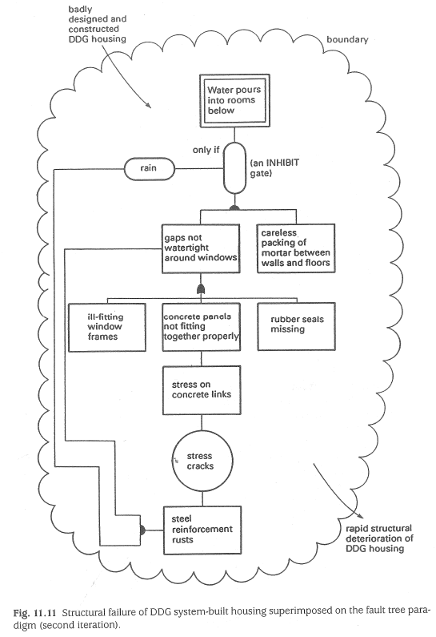

Slide 32
Stage 3: Meaning of Comparisons
Formal system paradigm vs the DDG project system
What are discrepancies between FSP and DDG?
No actual control subsystem (4 chairmen met only one in 14 years)
No formal performance monitoring sub-system (only informal way)
 | Paradigm
 | Desirable | Undesirable
No / Few Discrepancies
Many Discrepancies | X

Slide 33
Stage 3: Meaning of Comparisons
Control paradigm vs the DDG project system
What are discrepancies between Control and DDG?
No proper monitoring during design, tendering and construction
No control action during design, tendering, construction and the post-construction until tenants’ complaints
 | Paradigm
 | Desirable | Undesirable
No / Few Discrepancies
Many Discrepancies | X

Slide 34
Stage 3: Meaning of Comparisons
Communication paradigm vs Designer’s checking of Swallow’s tender
No sufficient data to say mismatch. There appears to be a match since it seems there was a communitaicotn (designer asked question to Swallow and got answers).
But...
What was the communication channel?
Why receiver failed to percieve the difficulties?...
Further iteration involving data collection needed
 | Paradigm
 | Desirable | Undesirable
No / Few Discrepancies | X
Many Discrepancies

Slide 35
Stage 3: Meaning of Comparisons
Cascade paradigm vs Structural failure of panels culminating in water pouring into rooms
There is a direct match for Positive Feedback loops
…the more the concrete panels fail to fit together; the greater the stress on concrete links…
...the greater the stress on the concrete links; the more the panels do not fit together properly…
 | Paradigm
 | Desirable | Undesirable
No / Few Discrepancies |  | X
Many Discrepancies

Slide 36
Stage 3: Meaning of Comparisons
Fault tree paradigm vs Structural failure of panels culminating in water pouring into rooms
There is a direct match, as expected from cascade comparison.
 | Paradigm
 | Desirable | Undesirable
No / Few Discrepancies |  | X
Many Discrepancies

Slide 37
Stage 4: Lessons
Apparent failures of the DDG project system offer:
Proper management needed, i.e. Competent direction and control
Effective monitoring of every phase required
Communication on a formal written basis required
Potential difficulties for the design and construction shall be highlighted.
Strict quality control checks required fro prefabricated units and on-site construction.

Slide 38
Thanks

